Slide 1

Analysis of Health, Environmental, and Socioeconomic Factors Across Global Populations
BERNABEO Bernard
CAMOTA, King Eluard
SANDATE, Maria del Carmen
SINGSON, Trizzia Ellaine

Slide 2

Dataset Overview
Covers 188 recognized countries
Spans a 10-year period (2012–2021)
Includes global health, demographic, economic, and environmental metrics
1,880 total data points (188 countries × 10 years)
Notes:
The dataset provides a curated and comprehensive overview of global health, demographic, economic, and environmental metrics for 188 recognized countries over a period of 10 years (2012-2021). This results in a total of 1880 data points (188 countries × 10 years).

Slide 3

Data Source
Source:
Kaggle (Global Health and Development 2012–2021)
Compiled from:
World Bank, World Health Organization (WHO)
Includes:
29 variables covering key global metrics
Demographic & Geographic Information
Health Indicators
Economic Indicators
Social Development Indicators

Slide 4

29 variables covering key global metrics
Demographic & Geographic Information
Country
Total Population
Female Population
Male Population

Slide 5

29 variables covering key global metrics
2. Health Indicators
Life Expectancy in Years (Male, Female)
Infant Deaths per 1000 Live Births
Hospital Beds Per 1000 People
Immunization Rate (%)
Tuberculosis Cases per 100,000 inhabitants
Suicide Rate (%)
Obesity Rate (%)
Underweight Rate (%)
Overweight Rate (%)

Slide 6

29 variables covering key global metrics
3. Economic Indicators
Unemployment Rate
GDP Per Capita
Sanitary Expense Per GDP
Sanitary Expense Per Capita
Labour Force Total

Slide 7

29 variables covering key global metrics
3. Social Development Indicators
Fertility Rate
Urban Population (%)
Alcohol Consumption Per Capita
Water Access (%)
CO2 Exposure (%)
Safe Water Access (%)

Slide 8

Data Bias
Reporting Bias
Different countries may use varying methodologies or definitions for the same indicators, leading to inconsistencies.
Measurement Bias
Differences in data collection methods between organizations (World Bank vs. WHO) may introduce inconsistencies.

Slide 9

Problem
Global health disparities persist, with significant variations in life expectancy and infant mortality across countries. Factors such as gender, socioeconomic conditions, and environmental influences contribute to these disparities, often leading to poorer health outcomes in low-income or underserved populations. This study analyzes a global health dataset to better understand these factors and identify potential solutions to improve health equity worldwide.
Objective 1
Objective 2
Objective 3
What are the differences in life expectancy between genders when categorized into distinct ranges?
What economic and social factors most influence lower life expectancy in gender?
How do socioeconomic and environmental factors impact infant mortality across countries over a 10-year period?
Notes:
Understanding the disparities in life expectancy and infant mortality across different demographics is crucial for shaping effective health and social policies. This study aims to analyze a dataset compiled from World Bank and WHO sources, covering 188 countries over a 10-year period (2012–2021), to explore key health and development trends.
By addressing these objectives, this study seeks to provide insights into the underlying factors affecting public health outcomes, enabling policymakers to design targeted interventions for improving life expectancy and reducing infant mortality globally

Slide 10
Data Cleaning Process
Handling Missing Data
Grouping & Aggregating by Country
Why: Group data by country (10-year period) to capture country specific trends.
Aggregate using the median to reduce the impact of outliers.
Select Relevant Variables
Why: Focus only on parameters of interest to align with the specific objective.
Avoid dropping data if no parameters are excluded, preserving data integrity.

Slide 11
Systematic Literature Review
Fadhilah Fitri (2021) begins with descriptive analysis to summarize both response and explanatory variables, followed by exploratory analysis to examine correlations between variables.
Modeling Process:
Poisson Regression: The model parameters are estimated, and the Akaike Information Criterion (AIC) is calculated to evaluate model fit.
Overdispersion Testing: If the assumption that the mean equals the variance is violated, the study shifts to Negative Binomial Regression to handle overdispersion.
Negative Binomial Regression: Model parameters are estimated, and regression parameter tests (both simultaneous and partial) are conducted.
Model Comparison: The AIC values of both models are compared, selecting the model with the lower AIC as the better fit.
Interpretation & Conclusion: The final model is analyzed, and conclusions and recommendations are made based on the findings.
This statistical approach ensures robust modeling of infant mortality data by addressing overdispersion and selecting the best-fitting model.

Slide 12
Systematic Literature Review
Exploratory Data Analysis
Poisson Regression Parameter Estimation
Overdispersion Test
No
Yes
Negative Binomial Parameter Estimation
Model Interpretation
Parameter Testing
Conclusion
Fadhilah Fitri (2021) Flow Chart

Slide 13
Objective 1:
What are the differences in life expectancy between genders when categorized into distinct ranges?

Slide 14
Objective 1: What are the differences in life expectancy between genders when categorized into distinct ranges?
Categorization of Life Expectancy (Female & Male)
Summary Statistics - Median Life Expectancy
Category | Definition (in years)
Low | < 60
Medium | 60 – 74.9
High | ≥ 75
76.09 years
FEMALE
High
69.30 years
MALE
Notes:
Life expectancy was divided into 3 meaningful categories for both genders:
This helped transform the continuous variable into a categorical one for better comparison.
Interpretation: Females live ~5 years longer on average, showing a consistent advantage in life expectancy globally.

Slide 15
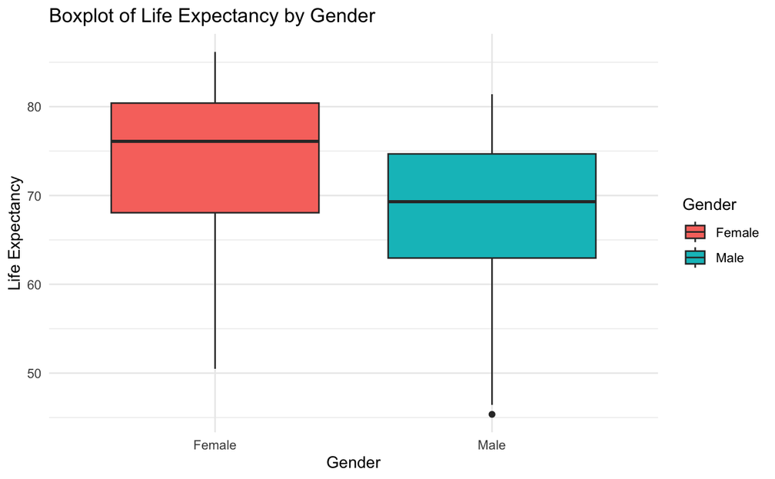
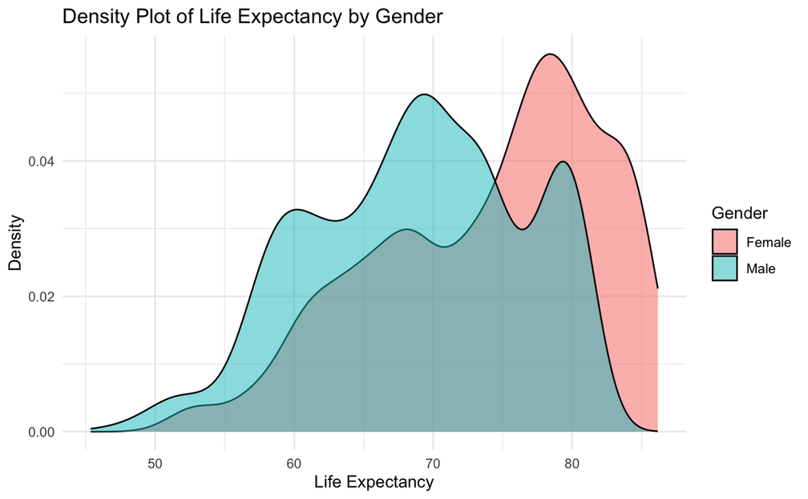
Objective 1: What are the differences in life expectancy between genders when categorized into distinct ranges?
Notes:
Boxplot
Shows that female distribution is higher than male across countries.
Presence of outliers in male life expectancy, indicating more variability.
Density Plot
Two peaks show distinct distributions by gender.
Female peak is shifted to the right, confirming higher life expectancy.
Interpretation: These plots reinforce the numerical summary — females have a higher and less variable life expectancy than males
Summary:
Bar Chart: Shows higher proportions of females in the High category.
Boxplot & Density Plot: Life expectancy is visibly higher and more consistent among females.

Slide 16
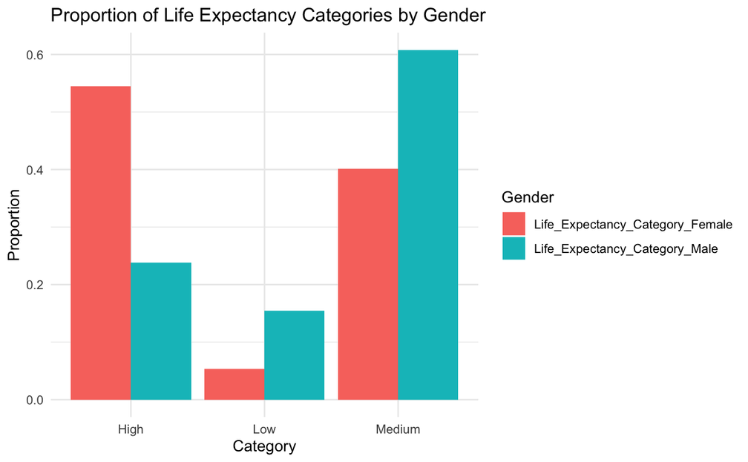
Objective 1: What are the differences in life expectancy between genders when categorized into distinct ranges?
Frequency Table
Category | Female | Male
High | 1002 | 438
Medium | 739 | 1118
Low | 99 | 284
Females
likely to be in the “High” life expectancy category.
Males
dominate the “Medium” and “Low” categories.
Gender differences persist even when categorized - females have a greater chance of being in the high longevity group.

Slide 17
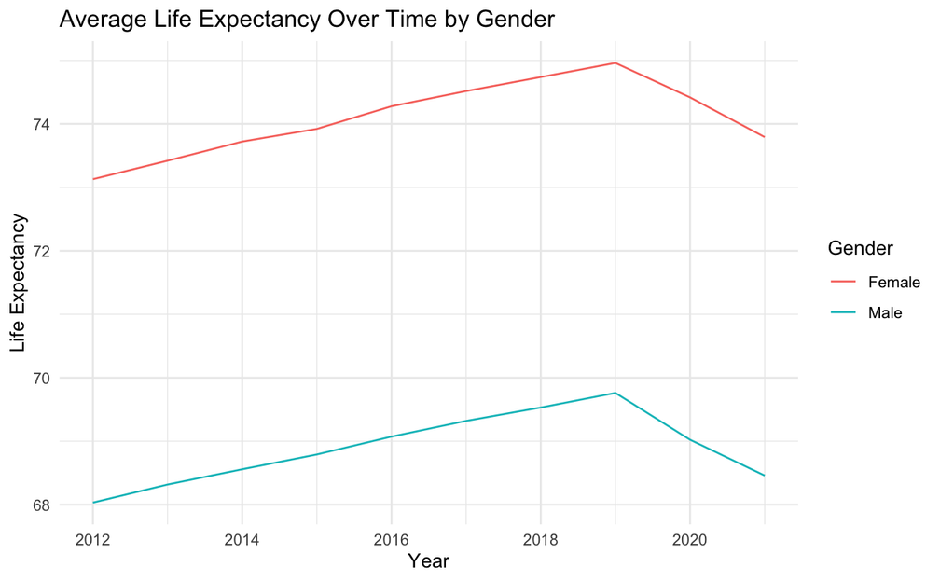
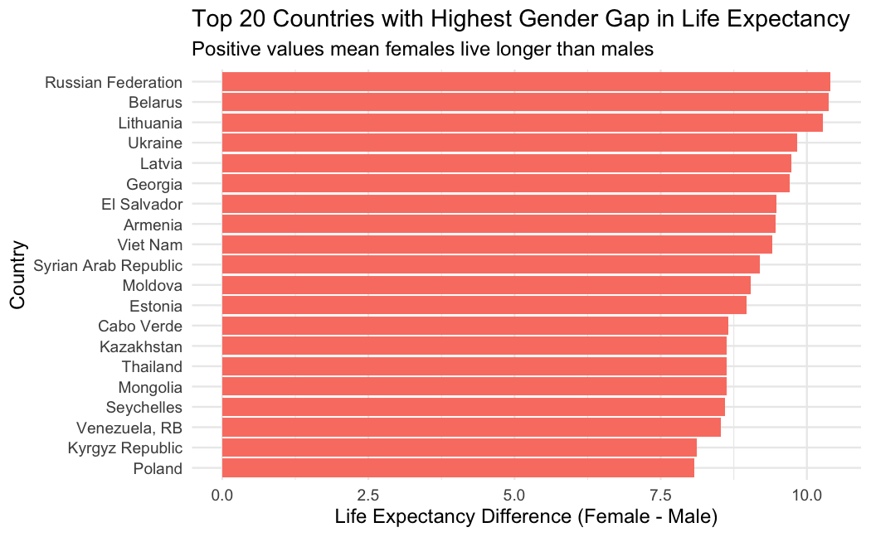
Objective 1: What are the differences in life expectancy between genders when categorized into distinct ranges?
Notes:
📈 Life Expectancy Over Time
Line Plot
Life expectancy has increased for both genders over the years.
Females consistently maintain a higher average than males across all years.
Interpretation: The gap persists over time, indicating that gender differences in life expectancy are not just a recent phenomenon
🌍 Gender Gap Across Countries
Bar Chart – Top 20 Countries
Countries like Russia, Belarus, Lithuania show the largest gender gaps (~10 years).
The gap is consistently in favor of females.
✅ Interpretation: While the gap varies by country, it is universally positive, meaning females live longer globally.

Slide 18

Objective 1: What are the differences in life expectancy between genders when categorized into distinct ranges?
Paired t-test
Are female & male life expectancies different?
Mean difference ≈ 5.20 years
p-value < 2.2e-16 → Statistically significant
💡 There’s strong evidence that females live longer than males, and the difference is not due to random chance.
ANOVA
F = 398.3, p-value < 2e-16 ***
💡 Gender is a significant factor affecting life expectancy across the dataset.

Slide 19

Objective 1: What are the differences in life expectancy between genders when categorized into distinct ranges?
Binomial Test
Is ≥ 50% of females in High Life Expentancy category?
💡 A significantly greater-than-50% share of females fall into the High life expectancy category.
Proportion / Score Test
Do female and male populations differ significantly in their likelihood of being in the High category?
💡 p-value < 2.2e-16. There is strong statistical evidence that females are more likely to fall into the High life expectancy group than males.
Notes:
"To statistically confirm the visual trends, we conducted a binomial and a two-sample proportion test.
We found that more than 54% of females fall into the high life expectancy category, which is significantly greater than 50%.
Moreover, females are over twice as likely as males to be in the high category.
This confirms our conclusion that gender plays a statistically significant role in life expectancy."
Key takeaway: There is strong evidence that females are overrepresented in the high life expectancy group.
Most of the tests we conducted — especially the binomial and proportion tests — point to a statistically significant gender difference in life expectancy. Females are more likely to fall into the high life expectancy category.
"Most tests strongly confirm a statistically significant gender difference in life expectancy. Females are more likely to fall into the high longevity category, and this is supported by both focused and general association tests."

Slide 20

Objective 1: What are the differences in life expectancy between genders when categorized into distinct ranges?
Chi-square Test
Is there an association between gender and life expectancy category (Low/Medium/High)?
💡 Since the p-value (< 2.2e-16) is far below 0.05, we reject the null hypothesis that gender and life expectancy category are independent.
💡 There is a statistically significant association between gender and life expectancy category.
💡 The distribution of Low, Medium, and High categories differs significantly between males and females.
Notes:
Based on the data, females are significantly more likely to fall into the High life expectancy category than males.
Across multiple statistical methods — including binomial, proportion, and t-tests — the results consistently show a gender-based disparity in life expectancy.

Slide 21







Result and Interpretation
Females are significantly more likely to be in the High Life Expectancy category compared to males.
Across all statistical tests (binomial, t-test, chi-square, etc.), the results consistently show a gender gap in favor of females.
On average, females live ~5 years longer than males.
The proportion of females in the High category is 54.5%, while only 25.8% of males fall into this group.
Boxplots & Density plots: Show a consistent advantage in female life expectancy
💡 Gender is a significant determinant of life expectancy. Globally, females are more likely to live longer than males.
Notes:
Statistical Evidence:
Binomial Test (Female High Category ≠ 50%):
→ Significant, p < 0.001
Proportion Test (Female vs. Male in High Category):
→ Significant, p < 0.001
Chi-Square Test (Gender vs. Category Association):
→ Strong Association, p < 0.001
Paired t-test & ANOVA:
→ Confirm females live longer on average

Slide 22
Objective 2:
What economic and social factors most influence lower life expectancy in gender?

Slide 23

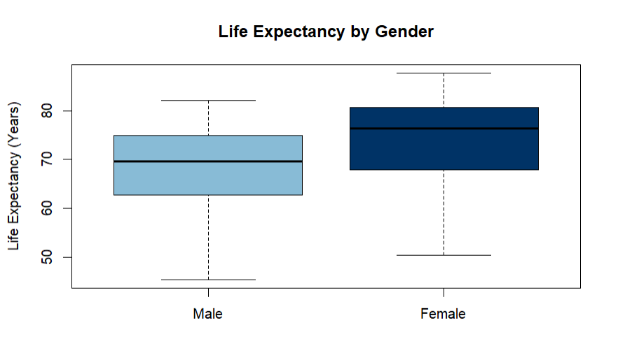
Objective 2: What economic and social factors most influence lower life expectancy in gender?

Slide 24
Chi-square test
-FEMALE
All four socioeconomic factors show a statistically significant relationship with female life expectancy.
Countries with higher GDP, urbanization, and water access, tend to have higher female life expectancy.
Countries with higher unemployment rates tend to have higher female life expectancy.
This result may reflect underlying social or economic factors not directly measured, such as access to healthcare, welfare systems, or regional characteristics.
Factor | Chi-Square Statistic | p-value | Conclusion
GDP per Capita | 630.32 | < 2.2e-16 | Significant association
Urban Population | 566.96 | < 2.2e-16 | Significant association
Unemployment Rate | 37.92 | 7.37e-10 | Significant association
Safe Water Access | 627.12 | < 2.2e-16 | Significant association

Slide 25
Chi-square test
-MALE
Factor | Chi-Square Statistic | p-value | Conclusion
GDP per Capita | 457.93 | < 2.2e-16 | Significant association
Urban Population | 331.82 | < 2.2e-16 | Significant association
Unemployment Rate | 0.087 | 0.7682 | No significant association
Safe Water Access | 390.01 | < 2.2e-16 | Significant association
Three of the four factors (GDP, urbanization, and access to safe water ) show a strong statistical association with male life expectancy.
However, unemployment rate does not appear to be related to male life expectancy.

Slide 26
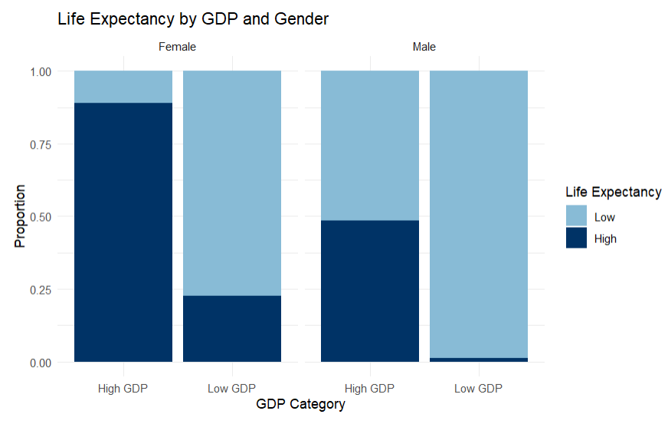
Impact of GDP on Life Expectancy by Gender
Male life expeHigher GDP is linked to higher life expectancy in both genders.
The effect is stronger in females, with a clear GDP-based gap.
Male life expectancy stays mostly low, even in high GDP countries → possible gender gap.

Slide 27
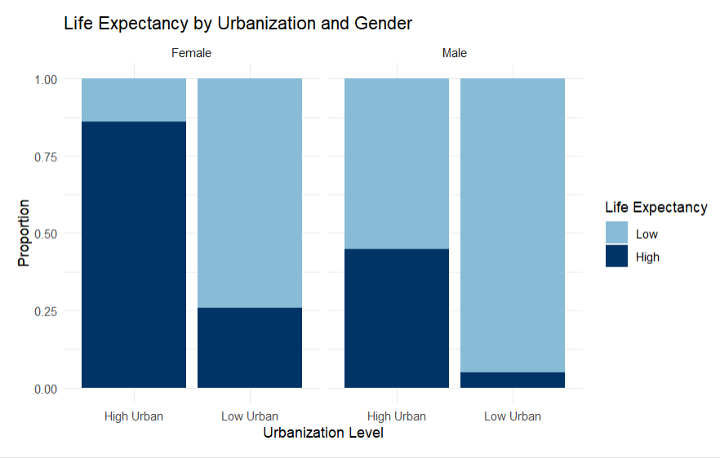
Life Expectancy by Urbanization and Gender
High urbanization is linked to higher life expectancy, especially in females.
Women in high urban countries show the highest proportion of long life expectancy.
For males, the effect exists but is less pronounced.
Low urbanization is associated with lower life expectancy in both genders, more so for males.

Slide 28
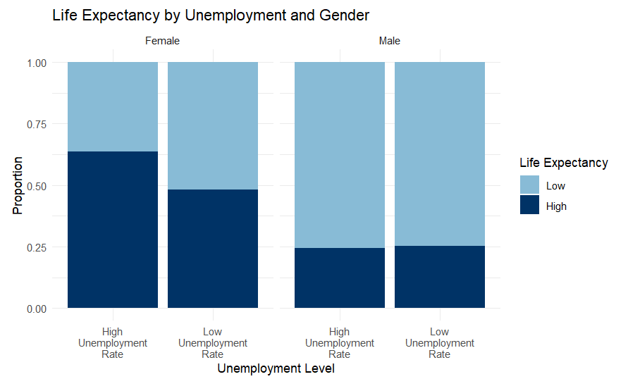
Life Expectancy by Unemployment and Gender
For females, high unemployment is surprisingly linked to a higher proportion of high life expectancy.
Low unemployment in females shows a more balanced split between high and low life expectancy.
For males, life expectancy is low in both unemployment categories — no major difference.
Suggests that unemployment rate has little or no impact on male life expectancy

Slide 29
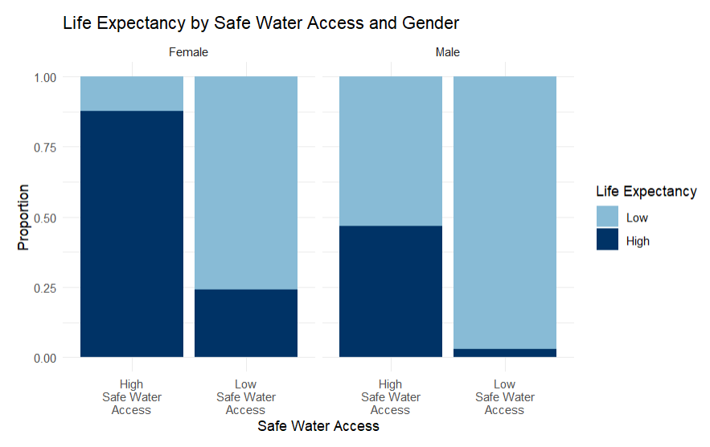
Life Expectancy by Safe Water Access
Female life expectancy is much higher in countries with high access to safe water.
For males, the difference is also clear, though less dramatic.
Low access to safe water is strongly associated with low life expectancy in both genders.
Safe water access appears to be one of the strongest predictors of life expectancy across genders.

Slide 30
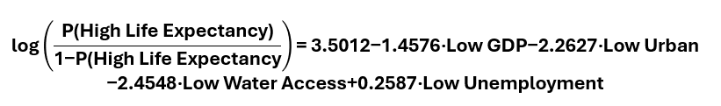
Logistic Regression: Predictors of Female Life Expectancy
Effect of GDP on Female Life Expectancy
Holding all other variables constant, the odds of having high female life expectancy in countries with low GDP are approximately 77% lower than in countries with high GDP. Strong evidence of a GDP effect (p < 2e-16).

Slide 31
Logistic Regression: Predictors of Female Life Expectancy
Effect of Urbanization on Female Life Expectancy
Countries with low urbanization have about 90% lower odds of high female life expectancy compared to highly urbanized countries, after controlling for other variables. Strong urbanization effect (p = 1.15e-15).

Slide 32
Logistic Regression: Predictors of Female Life Expectancy
Effect of Urbanization on Female Life Expectancy
The odds of high female life expectancy in countries with poor access to safe water are about 91% lower than those with good access, controlling for GDP, urbanization, and unemployment. Very strong effect (p < 2e-16).

Slide 33
Logistic Regression: Predictors of Female Life Expectancy
Effect of Unemployment on Female Life Expectancy
Unemployment effect is not statistically significant (p = 0.139)

Slide 34
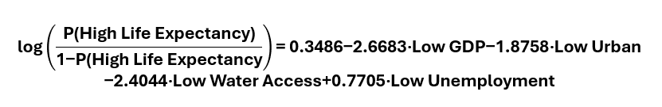
Logistic Regression: Predictors of Male Life Expectancy
Effect of GDP on Male Life Expectancy
Holding all other variables constant, countries with low GDP have 93% lower odds of high male life expectancy compared to those with high GDP. Strong GDP effect (p =5.79e-15).

Slide 35
Logistic Regression: Predictors of Male Life Expectancy
Effect of Urbanization on Male Life Expectancy
Countries with low urbanization have 85% lower odds of high male life expectancy than highly urbanized countries, adjusting for other variables. Strong urbanization effect (p < 2e-16).

Slide 36
Logistic Regression: Predictors of Male Life Expectancy
Effect of Urbanization on Male Life Expectancy
Countries with poor access to safe water have 91% lower odds of high male life expectancy than countries with good access. Very strong effect (p < 2e-16).

Slide 37
Logistic Regression: Predictors of Male Life Expectancy
Effect of Unemployment on Male Life Expectancy
Countries with low unemployment have more than twice the odds (OR ≈ 2.16) of high male life expectancy compared to those with high unemployment. This time, the effect is statistically significant (p = 3.00e-06)

Slide 38
Objective 3:
How do socioeconomic and environmental factors impact infant mortality across countries over a 10-year period?

Slide 39
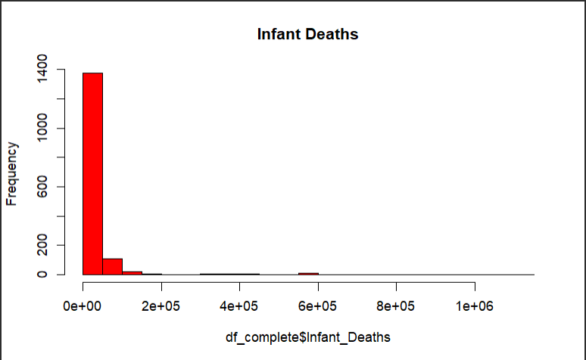
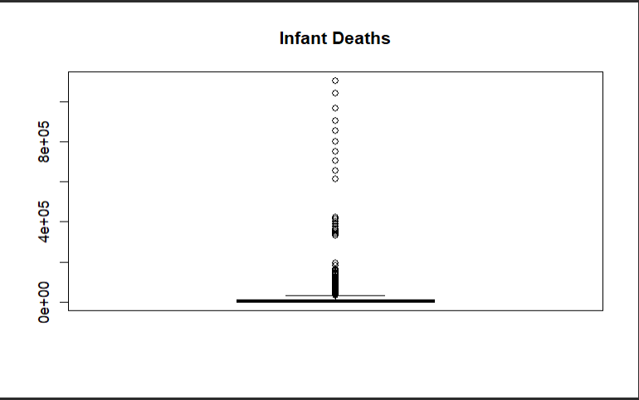
Objective 3: How do socioeconomic and environmental factors impact infant mortality across countries over a 10-year period?

Slide 40
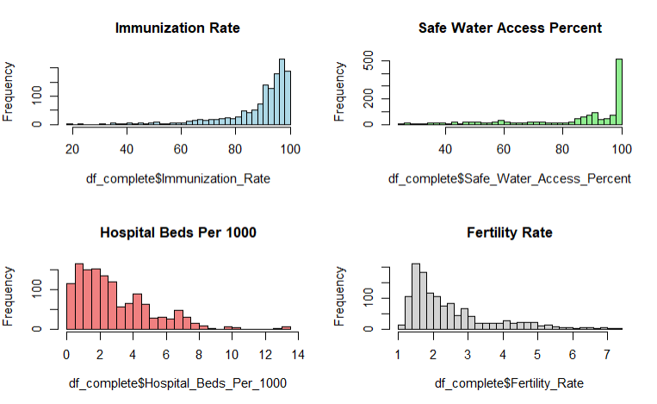
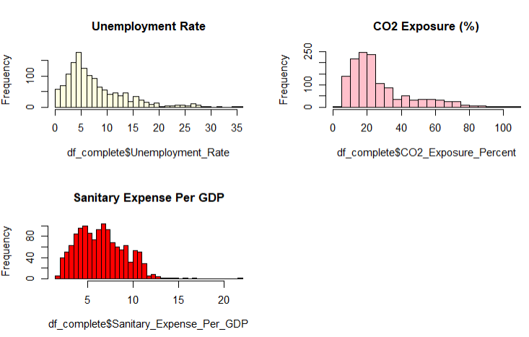
Objective 3: How do socioeconomic and environmental factors impact infant mortality across countries over a 10-year period?

Slide 41
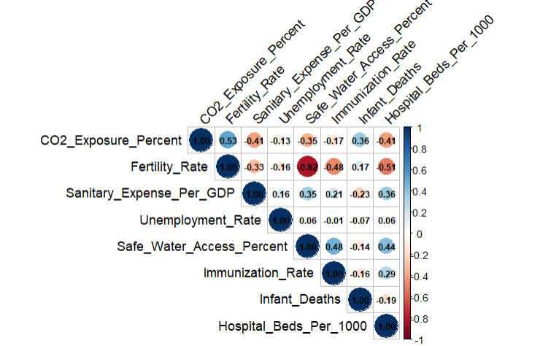
Objective 3: How do socioeconomic and environmental factors impact infant mortality across countries over a 10-year period?

Slide 42
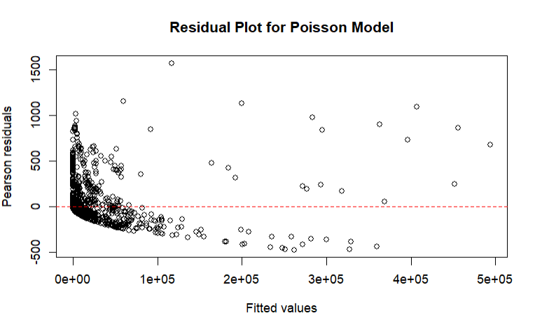
Poisson Regression Model
Coefficients | Estimate | p-value
Intercept | 14.20 | <2e-16 ***
CO2 Exposure (%) | 0.043 | <2e-16 ***
Fertility Rate | -0.332 | <2e-16 ***
Sanitary Expense Per GDP | -0.216 | <2e-16 ***
Unemployment Rate | 0.0006 | <2e-16 ***
Safe Water Access (%) | -0.012 | <2e-16 ***
Immunization Rate | -0.028 | <2e-16 ***
Hospital Beds | -0.177 | <2e-16 ***

Slide 43
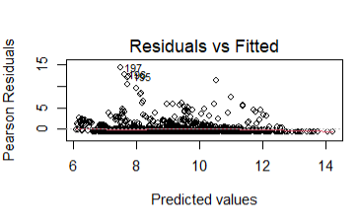
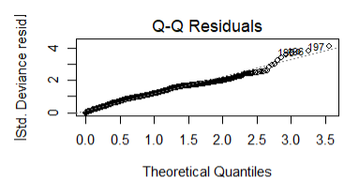
Negative Binomial Regression Model
Coefficients | Estimate | p-value
Intercept | 15.46 | <2e-16 ***
CO2 Exposure (%) | 0.049 | <2e-16 ***
Fertility Rate | -0.24 | 0.0002 ***
Sanitary Expense Per GDP | -0.098 | 5.46e-08 ***
Unemployment Rate | -0.074 | <2e-16 ***
Safe Water Access (%) | -0.025 | 1.22e-11 ***
Immunization Rate | -0.04 | <2e-16 ***
Hospital Beds | -0.137 | 1.25e-10 ***

Slide 44
Objective 3: How do socioeconomic and environmental factors impact infant mortality across countries over a 10-year period?
Model Comparison
Model | Dispersion | AIC
Poisson Model | 57,568.31 | 52,279,540
Negative Binomial Model | 1.98 | 25,415.35

Slide 45








Result and Interpretation
A 1% increase in CO2 exposure leads to a 5% increase in infant deaths per 1000 live births.
A 1-unit increase in fertility rate correlates with a 19.8 % decrease in infant deaths per 1000 live births.
A 1% increase in sanitation spending (as a percentage of GDP) leads to 9.4% decrease in infant deaths per 1000 live births.
A 1% increase in unemployment correlates with a 7.1% decrease in infant deaths per 1000 live births.
A 1% increase in access to safe water reduces infant deaths per 1000 live births by 2.2%.
💡 CO₂ exposure, fertility rate, sanitary expense per GDP, unemployment rate, safe water access, immunization rate, and hospital beds are significant predictors of infant mortality. These findings highlight the critical role of environmental quality, economic conditions, and healthcare infrastructure in shaping infant mortality rates globally.
A 1% increase in immunization coverage reduces infant deaths per 1000 live births by 4%.
A 1% unit increase in hospital beds per 1000 population leads to a 12.7% decrease in infant deaths per 1000 live births.
Notes:
Statistical Evidence:
Binomial Test (Female High Category ≠ 50%):
→ Significant, p < 0.001
Proportion Test (Female vs. Male in High Category):
→ Significant, p < 0.001
Chi-Square Test (Gender vs. Category Association):
→ Strong Association, p < 0.001
Paired t-test & ANOVA:
→ Confirm females live longer on average

Slide 46
Limitation of the Study
Limited Predictive Power: Current model explains only 45% of infant deaths, indicating missing key factors.

Slide 47
Recommendations
Expand Predictors: Include other variables that could affect infant mortality.
Add Interaction Terms: Analyze how combined factors (e.g., CO2 exposure & Fertility Rate) impact infant mortality.

Slide 48
Thank You

Slide 49
References
Fadhilah Fitri. (2021). Infant Mortality Case: An Application of Negative Binomial Regression in order to Overcome Overdispersion in Poisson Regression. https://doi.org/10.1007/s40615-017-0381-x
‌

Slide 50
Contribution
25%
25%
25%
25%
Bernard Bernabeo
King Eluard Camota
Maria del Carmen Sandate
Trizzia Ellaine Singson

